Slide 1
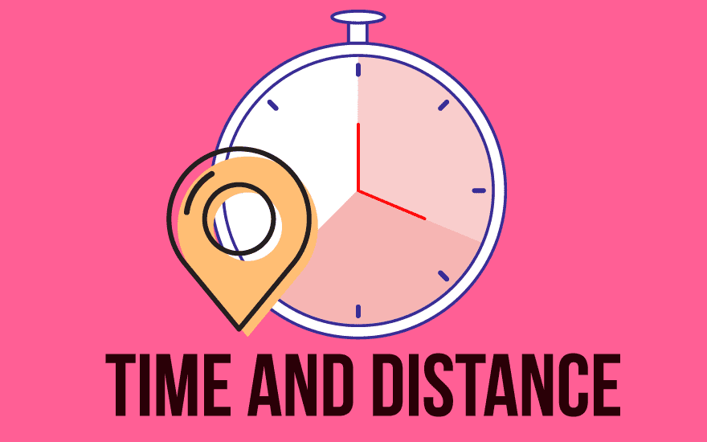
pea 516
Lecture-6
Time and distance

Slide 2
Contents:
Concept of time speed and distance
Conversion of units

Slide 3
BASIC RELATIONS :
Distance: The numerical description of “How far two objects” is called distance.
Time: It is a component to compare the “durations of events” and the “intervals”
Speed= Distance/Time

Slide 4
The 3 formulas for Speed, Time & Distance:
Distance
Distance
Speed =
Time =
Distance =
Speed x
Time
Time
Speed
Solving for Speed
Solving for Time
Solving for Distance
Remember them from
this triangle:
D
S
T

Slide 5
Ex.1 A windsurfer travelled 28 km in 1 hour 45 mins.
Calculate his speed.

Slide 6
A windsurfer travelled 28 km in 1 hour 45 mins.
Calculate his speed.
Distance
Speed =
D
Time
S
T
28
=
1•75
1 hour 45 mins
= 16 km/h
Answer: His speed was 16 km / hour

Slide 7
Ex.2 A salesman travelled at an average speed of 50 km/h for 2 hours 30 mins. How far did he travel?
D
S
T

Slide 8
A salesman travelled at an average speed of 50 km/h for 2 hours 30 mins. How far did he travel?
D
Distance =
Speed x Time
S
T
= 50 x 2•5
2 hour 30 mins
= 125 km
Answer: He travelled 125 km

Slide 9
EX.3 A train travelled 555 miles at an average speed of 60 mph. How long did the journey take?
D
S
T

Slide 10
A train travelled 555 miles at an average speed of 60 mph. How long did the journey take?
Distance
D
Time =
Speed
S
T
555
=
60
= 9•25 hours
= 9 hours 15 mins
Answer: It took 9 hours 15 minutes

Slide 11
UNITS OF SPEED AND THEIR CONVERSION
Standard Units
The standard units of speed are as follows.
Unit Symbols
metres per second m/s
kilometres per hour km/h
miles per hour m/h
1 kilometre = 1000 metres
1 mile = 1.60934 kilometres or 1.6 kilometres
1 hour = 3600 seconds

Slide 12
Conversion of units from km/h to m/s and vice versa
1 km/h = 1000m / 3600s = 5m / 18s
So,
1 km/h = 5/18 m/s and 1 m/s = 18/5 km/h
1 km/h = 50/3 m/min and 1 m/min = 3/50 km/h

Slide 13
CONVERSION
Convert 36 km/hr into m/s
Convert 90 km/hr into m/s

Slide 14
CONVERSION
Convert 15 m/s into km/hr
Convert 20 m/s into km/hr

Slide 15
1) A person crosses a 600 m long street in 5 minutes. What is his speed in km per hour?
3.6
7.2
8.4
10

Slide 16
2) The ratio between the speeds of two trains is 7 : 8. If the second train runs 400 km in 4 hours, What is the speed of the first train?
85km/hr
87.5 km/hr
90 km/hr
None

Slide 17
3) A truck covers a distance of 550 meters in 1 minute whereas a train covers a distance of 33 kms in 45 minutes. What is the ratio of their speed?
a) 4:3
b) 3:4
c) 5:4
d) None

Slide 18
4) Two buses travel to a place at 45 km/h and 60 km/h respectively. If the second bus takes 5.5 hours less than the first for the journey, the length (all in km) of the journey is
900
945
990
1350

Slide 19
5) Ram starts from Ludhiana at 6 a.m. at a constant speed of 40 kmph. He halts at Jalandhar for half an hour and then drives at 70 kmph. He reaches Amritsar at 9.30 a.m. which is 180 km away from Ludhiana. What is the distance between Jalandhar and Amritsar?
120 km
140 km
100 km
130 km

Slide 20
6) A was travelling in a bus. After going 2/3rd of the total distance, the bus broke down. So he hired an auto and completed the rest of the journey. He found that the auto took twice the time the bus took. Find the ratio of the speed of the bus to that of the auto.
1 : 2
2 : 1
3 : 1
4 : 1

Slide 21
7. A person has to cover a distance of 8 km in 50 minutes. If he covers one-half of the distance in two-fifth of the total time, to cover the remaining distance in the remaining time, what should be his speed in km/hr?
A. 12 km/hr
B. 10 km/hr
C. 14 km/hr
D. 8 km/hr

Slide 22
8) If a person walks at 14 km/hr instead of 10 km/hr, he would have walked 20 km more. The actual distance travelled by him is:
A. 20 km
B. 50 km
C. 40 km
D. 80 km

Slide 23
9) Two cars start from A and B travel towards each other at speeds of 50 km/h and 60 km/h respectively. At the time of their meeting, the second car has travelled 120 kms more than the first. Find the distance between A and B.
A. 1320 km
B. 1550 km
C. 1450 km
D. 1280 km

Slide 24
10) There are 20 windmills with a constant distance between each pole. A car takes 22 seconds to reach the 12th pole. How much time will it take to reach the last pole?
36 seconds
38 seconds
40 seconds
42 seconds

Slide 25


